Slide 1
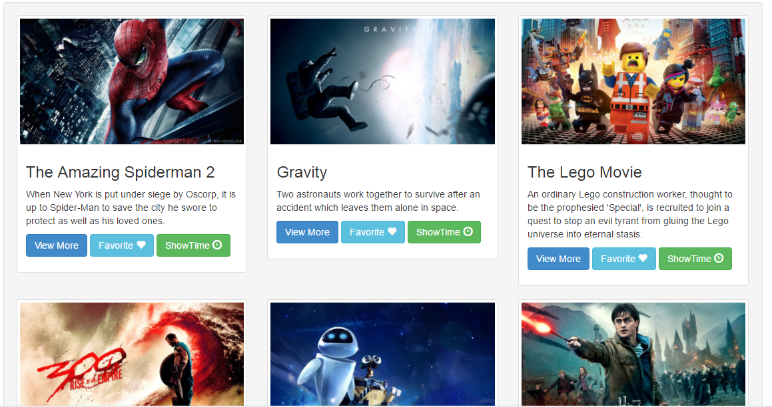
GET ME A SEAT

Slide 2
TEAM MEMBERS
S,Annamalai (H224346)
Siddarthan Gokulavani (H224243)
S,Hemalatha (H224402)
Team Members

Slide 3
Software Requirement
Front End : HTML, CSS, Bootstrap, Javascript, jQuery
Back End : MySQL, PHP
IDE : Brackets.io
Server : XAMPP
Software Requirement

Slide 4
DAY 1: TASK
Installed required software’s for this project.
Divided the project into three parts and we took the part which matches our individual skillsets.
S.Annamalai:
To create an UI for Booking seat.
To create a Seat Database.
S,Gokulavani:
To create an UI for Movie Home Page.
To create a Movie Database.
S,Hemalatha:
To create an UI for Signup/Login.
To create a User/Admin Database.
Day 1

Slide 5
DAY 2: TASK
S, Annamalai:
Blocking a seat when it is booked by a user.
When multiple users tries to book a seat, our application books based on FIFO.
Cancellation of seat.
S,Gokulavani:
Favorite Movie of a user.
ShowTime of each Movies.
Genres of each Movies.
S,Hemalatha:
Admin Level access in Database to update or delete movies.
Day 2

Slide 6
DAY 3:TASK
Completed tasks:
Integration of all our works.
Testing our application.
Uploaded in Git.
Yet to complete:
Post the movie details to Book seating database and UI.
Create a Ticket View for the user once a ticket Is booked.
Maintaining Session for each users.
Seat price raise/decrease.
Other ideas to implement:
Send a mail to user and admin once a ticket is booked.
Tried this part with PHP Mail() function.
Show movies to the user based on his interest.
We can do this by tracking his frequent booking practice.
Day 3

Slide 7
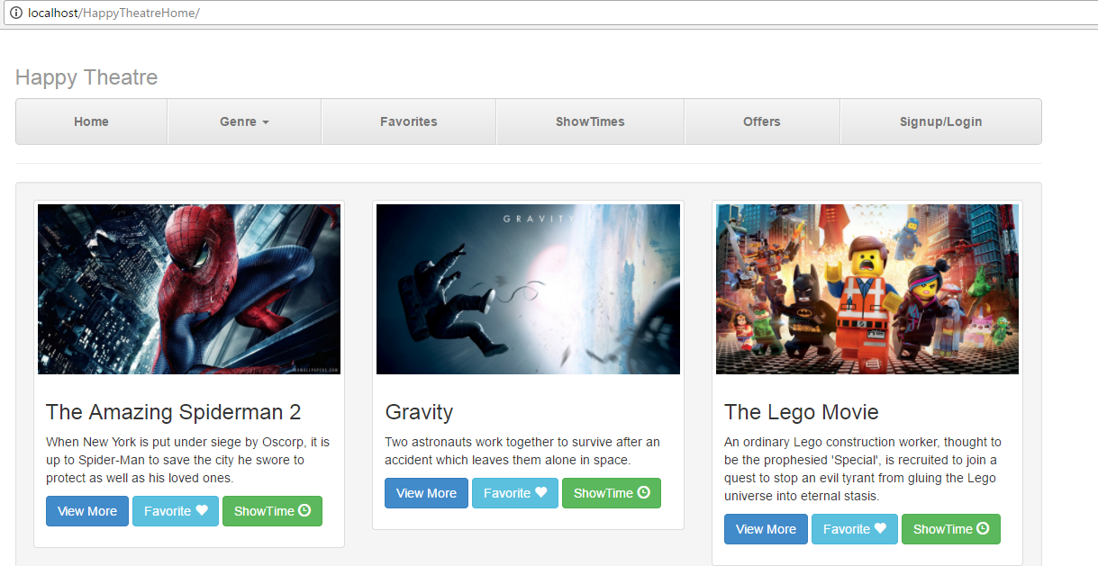
Home Page
Screenshots

Slide 8
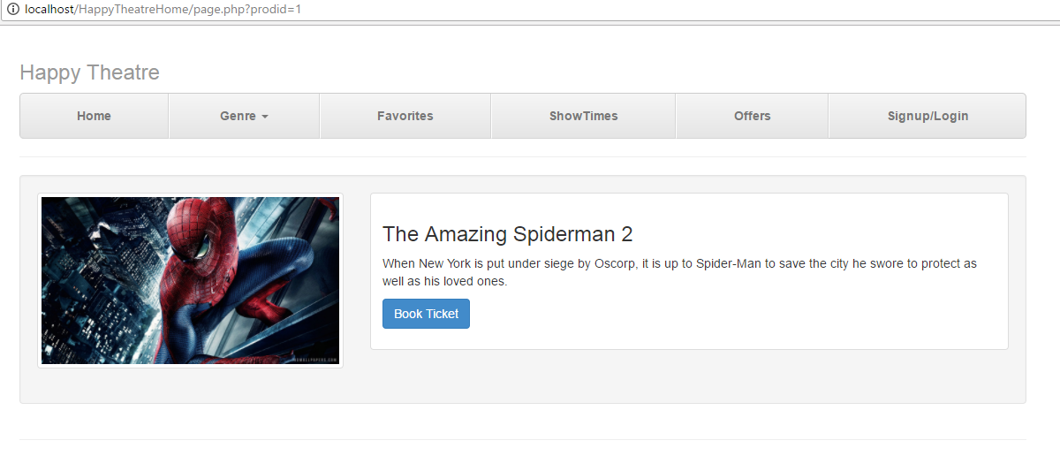
Viewing a Movie
Screenshots

Slide 9
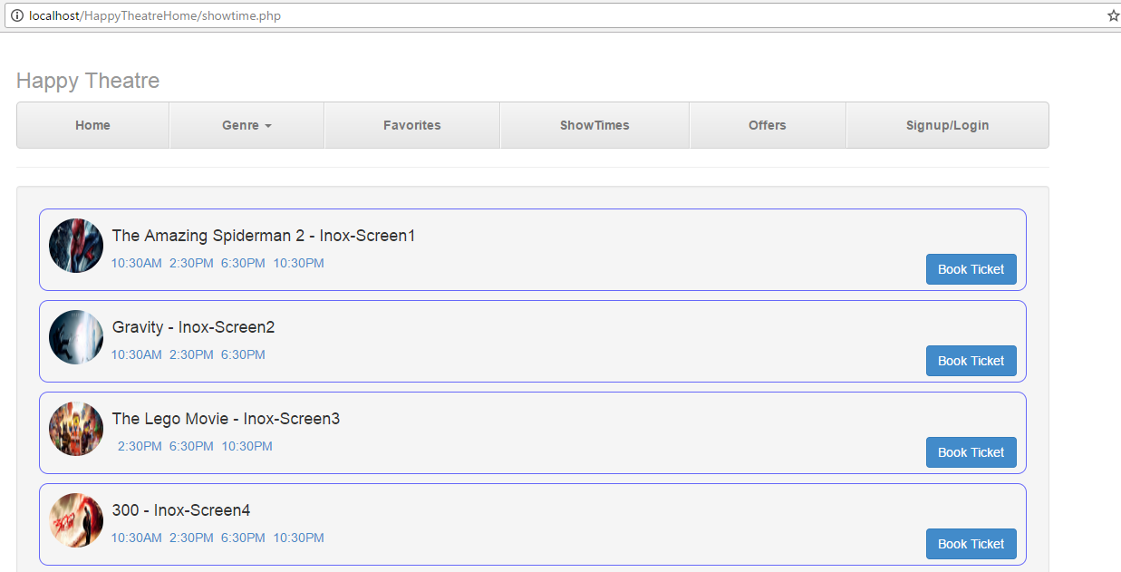
Show Timing
Screenshots

Slide 10
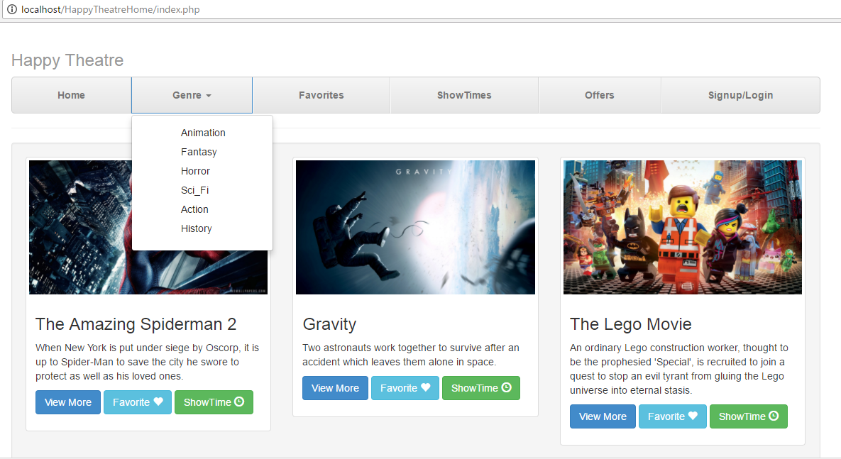
Genre
Screenshots

Slide 11
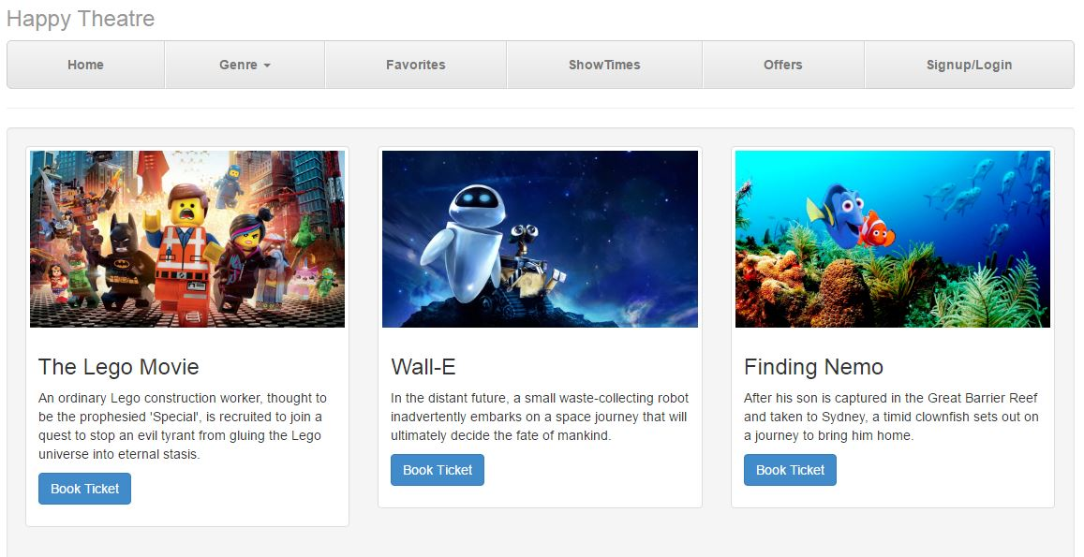
Genre - Animation
Screenshots

Slide 12
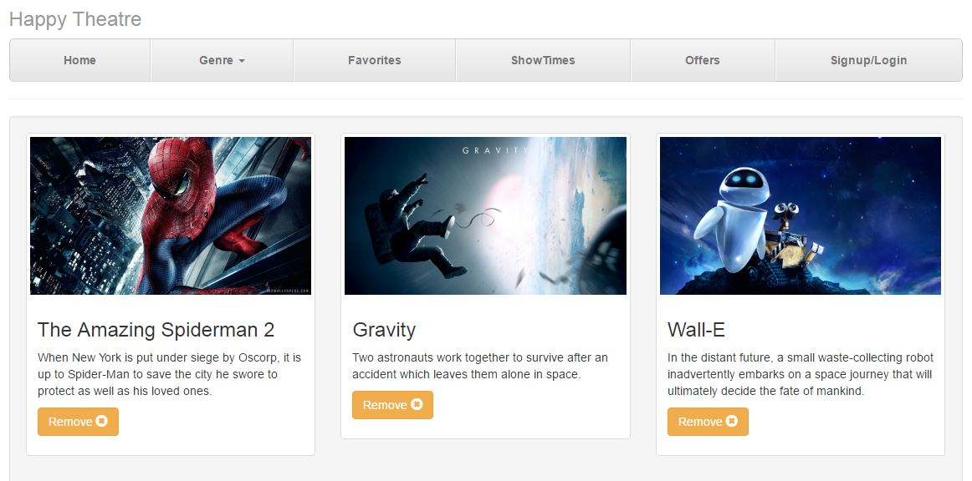
Favorite Movie
Screenshots

Slide 13
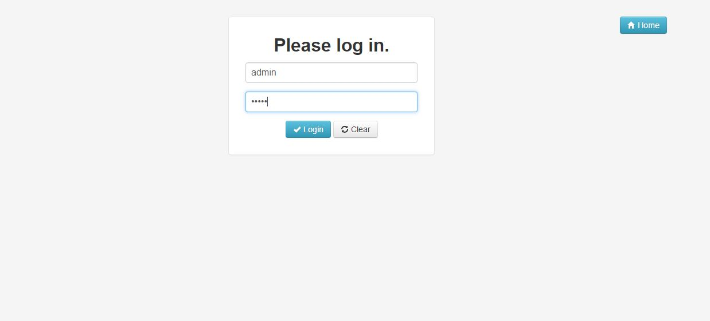
Log In - Admin
Screenshots

Slide 14
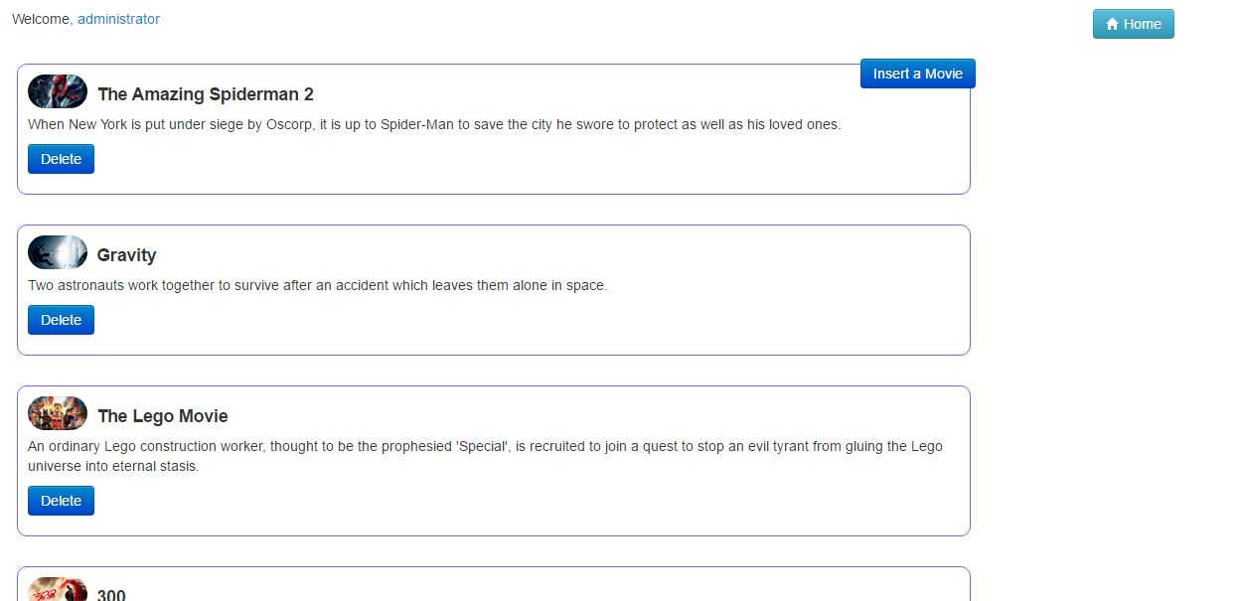
Admin Profile
Screenshots

Slide 15
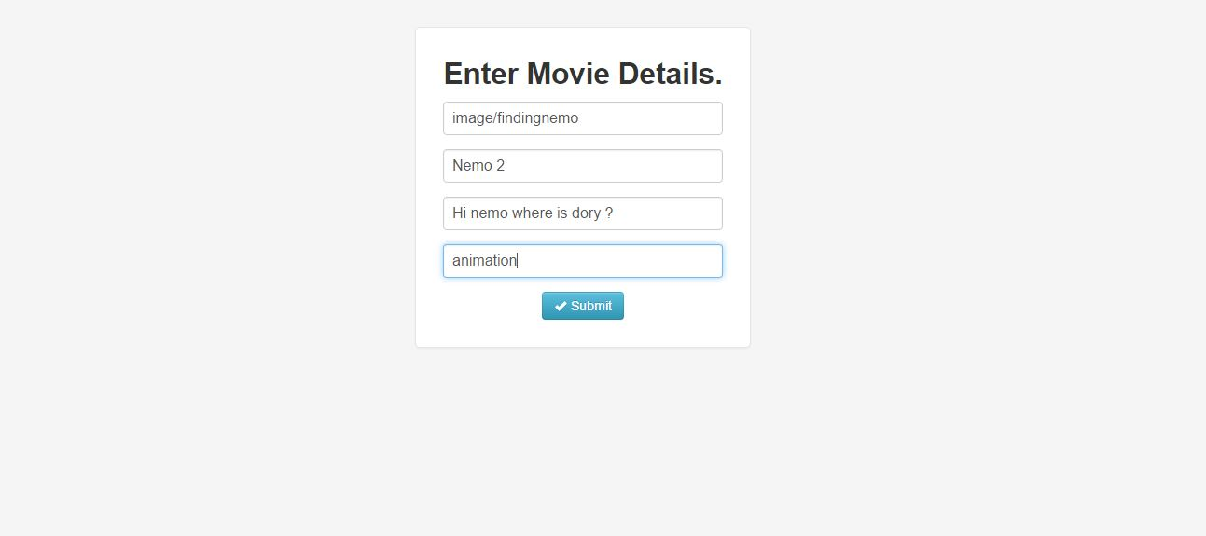
Inserting a Movie
Screenshots

Slide 16
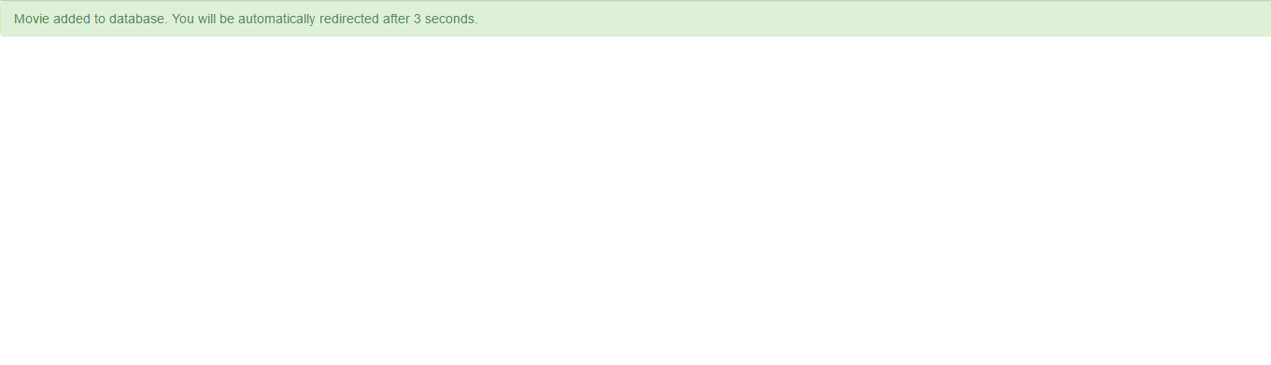
Success Message
Similarly admin can also delete a movie from database.
Screenshots

Slide 17
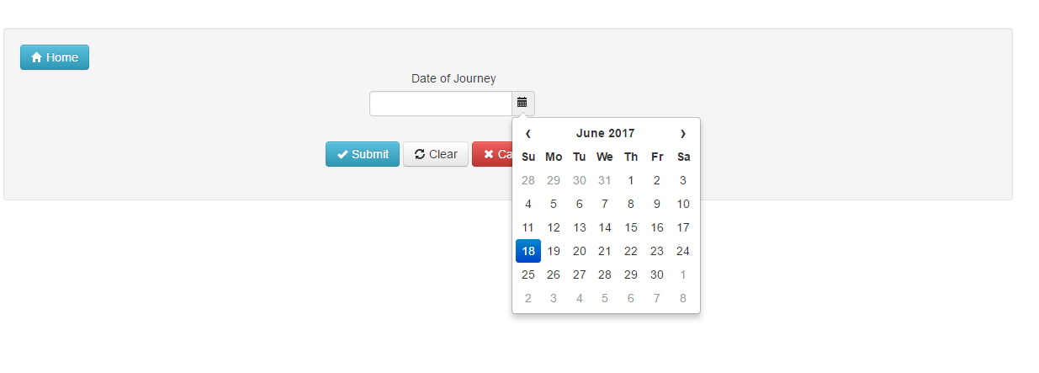
Booking a Seat
Screenshots

Slide 18
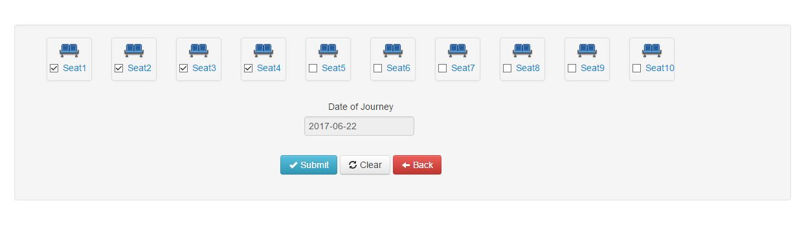
Seat selection
Screenshots

Slide 19
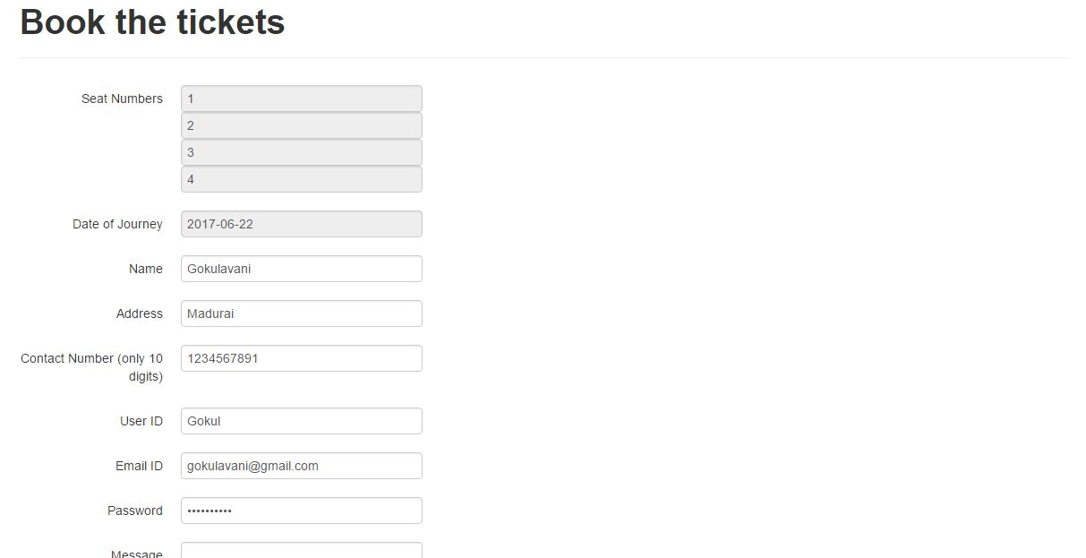
User signup
Screenshots

Slide 20
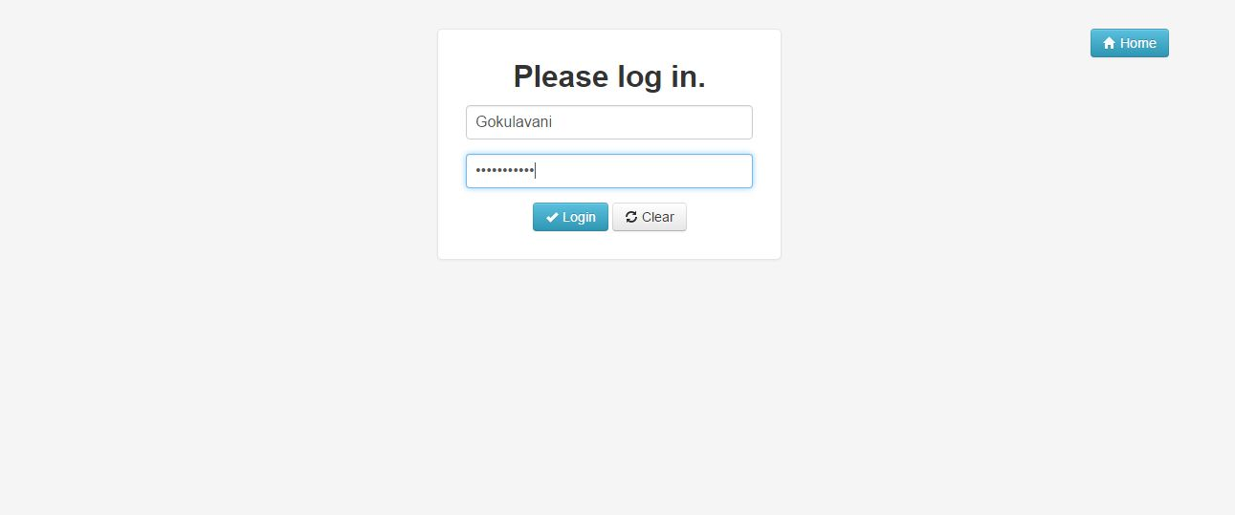
User Login
Screenshots

Slide 21
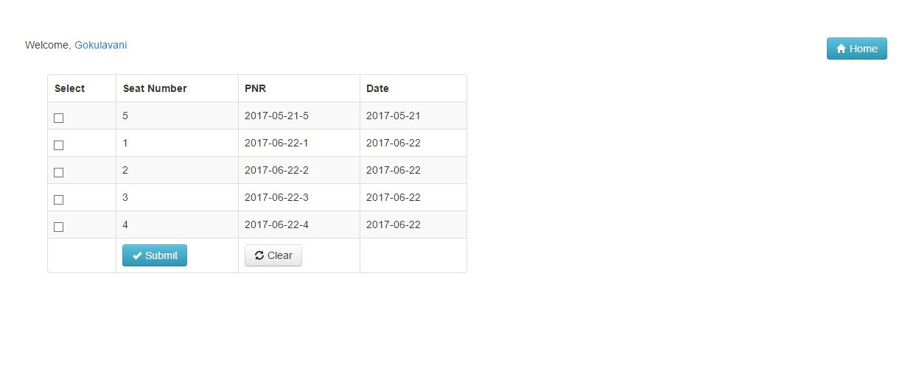
Viewing User Details
Screenshots

Slide 22
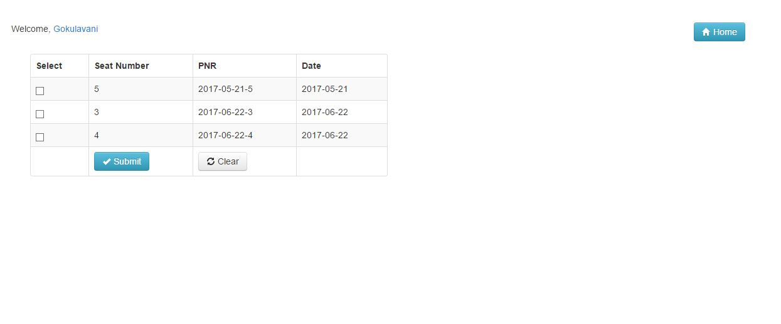
After Cancellation of seats
Screenshots

Slide 23
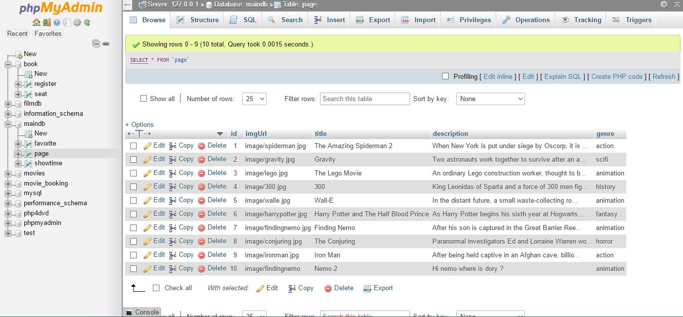
Movie Database

Slide 24
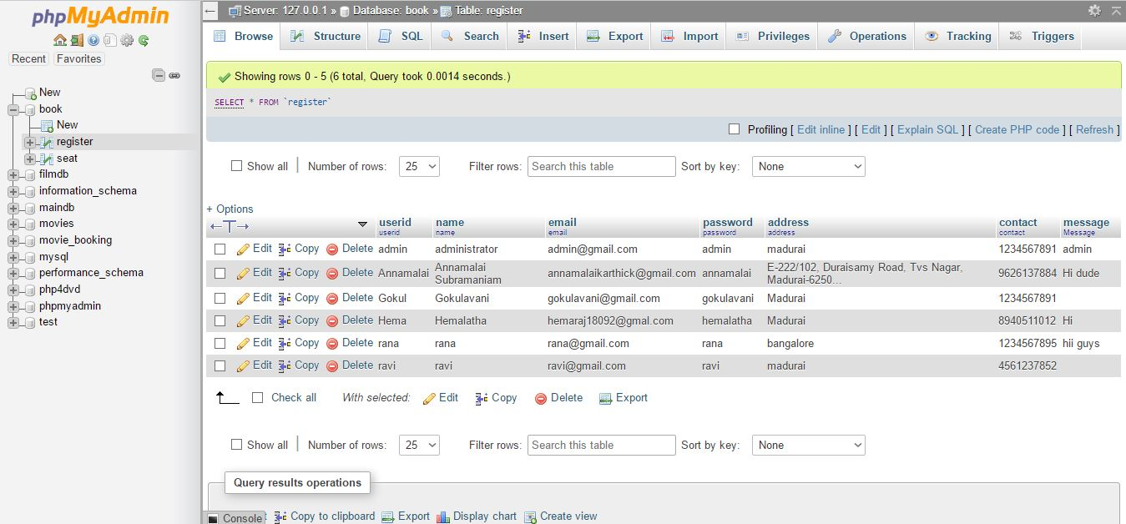
User Database

Slide 25
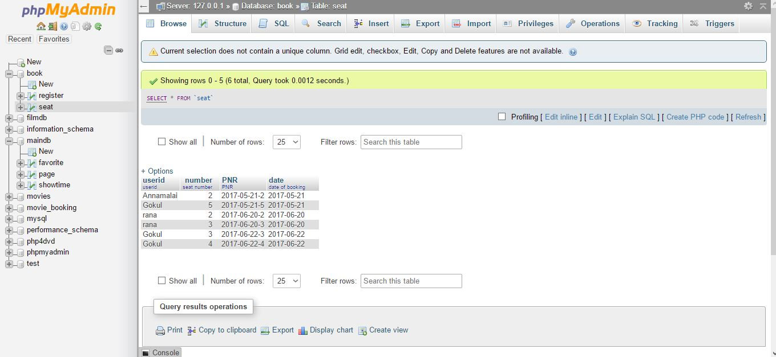
Seat Booking Database

Slide 26
Thank You !!

